Slide 1
EEE Lecture-8
CHAPTER 7: SERIES-PARALLEL CIRCUITS
*
‹#›

Slide 2
Contents
Objectives
7.1 Introduction
7.2 Series-Parallel Networks
7.3 Reduce and Return Approach
*
‹#›

Slide 3
7.2 Series-Parallel Networks
A series-parallel configuration is one that is formed by a combination of series and parallel elements.
There are no new laws or rules to learn—simply an approach that permits the analysis of such structures.
Two elements are in a series if
1. They have only one terminal in common (i.e., one lead of one is connected to only one lead of the other).
2. The common point between the two elements is not connected to another current-carrying element.
Two elements, branches, or networks are in parallel if they have two points in common.
In a series-parallel network, you must be very careful to determine which elements are in series and which are in parallel.
*
‹#›

Slide 4
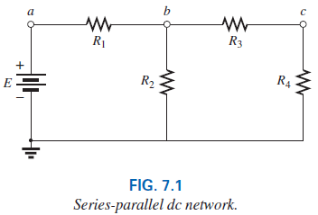
7.2 Series-Parallel Networks
Resistors R₁ and R₂ are not in series due to resistor R₃ connected to the common point b between R₁ and R₂
Resistors R₂ and R₄ are not in parallel because they are not connected at both ends. They are separated at one end by resistor R₃.
Two resistors R₃ and R₄ are in series because they share only point c, and no other element is connected to that point.
Further, the voltage source E and resistor R₁ are in series because they share point a, with no other elements connected to the same point.
In the entire configuration, there are no two elements in parallel.
*
‹#›

Slide 5
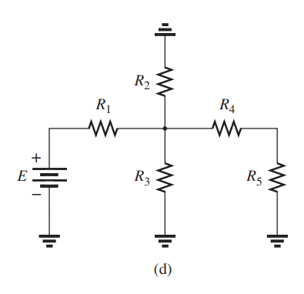
E and R1 in series,
R2 and R3 in parallel
R4 and R5 in series;
*
‹#›

Slide 6
7.2 How do we analyze such configurations?
General Approach:
Take a moment to study the problem “in total” and make a brief mental sketch of the overall approach you plan to use. The result may be time- and energy-saving shortcuts.
Examine each network region independently before trying them together in series-parallel combinations to simplify the network and reveals a direct approach.
Redraw the network as often as possible with the reduced branches to maintain clarity and provide the reduced networks for the trip back to unknown quantities from the source.
*
‹#›

Slide 7
7.2 How do we analyze such configurations?
Approaches to solve the series-parallel Networks:
Reduce and Return Approach
Block Diagram Approach
*
‹#›

Slide 8
7.3 Reduce and Return Approach
This process enables you to reduce the network to its simplest form across the source and then determine the source current.
In the return phase, you use the resulting source current to work back to the desired unknown.
For most single-source series-parallel networks, the above approach provides a viable option toward the solution.
*
‹#›

Slide 9
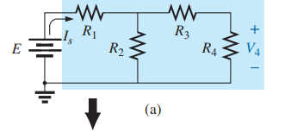
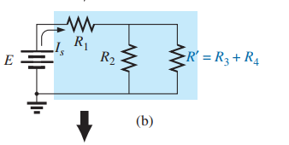
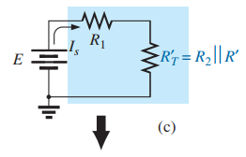
Reduce and Return Approach
First combine the series resistors R₃ and R₄ to obtain a equivalent resistor R´ as shown in (b).
R´ = R₃ + R₄
Then resistors R₂ and R´ is parallel as shown in (c).
R´_{T} = R₂ || R´
*
‹#›

Slide 10
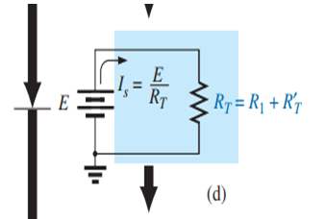
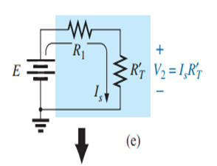
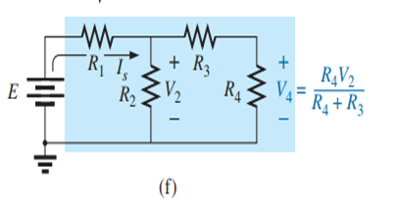
Reduce and Return Approach
Resistors R1 and R´_{T} are in series and can be combined to established the total resistance of the network shown in (d)
R_{T} = R₁ + R´_{T}
Is = E / R_{T}
Due to the resulting series configuration, the source current is also the current through R1 and R´_{T} and determined by Ohm’s law:
V₂ = Is R´_{T}
Finally, the desired voltage V4 can be determined by applying the voltage divider rule as shown in (f).
*
‹#›

Slide 11
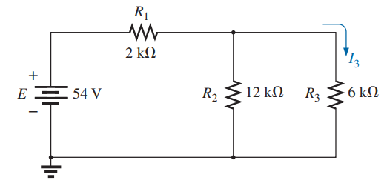
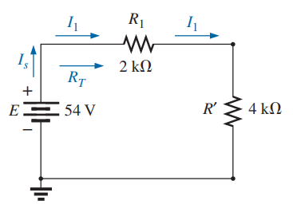
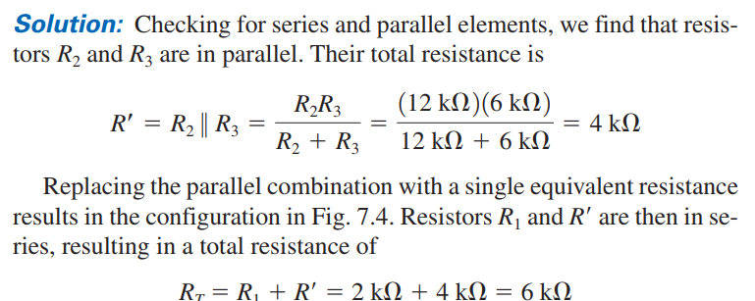
*
‹#›

Slide 12
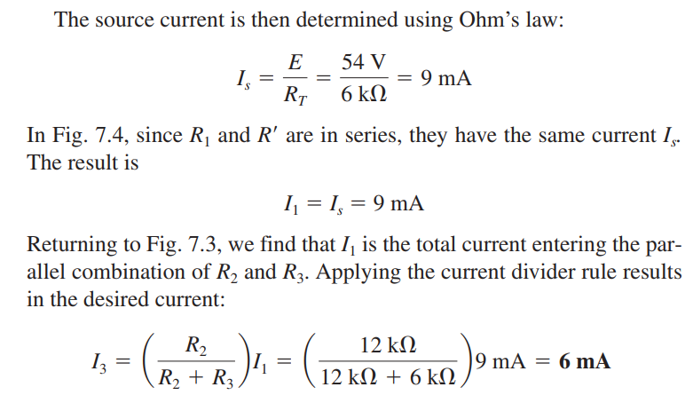
*
‹#›

Slide 13
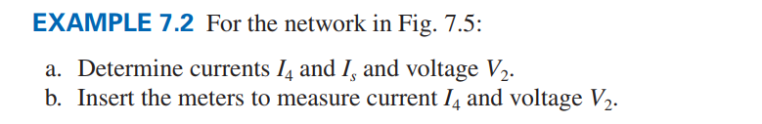
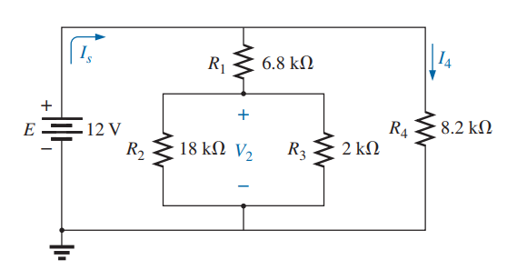
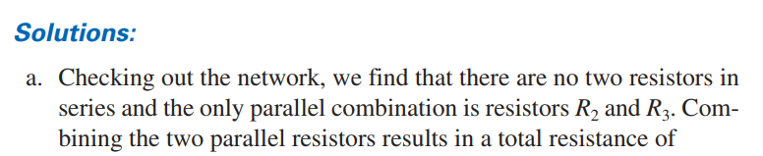

*
‹#›

Slide 14
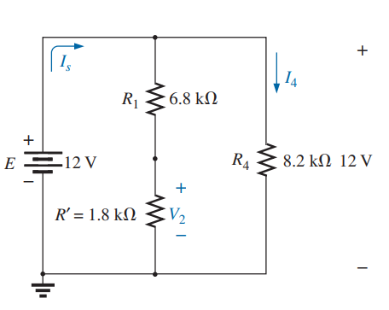

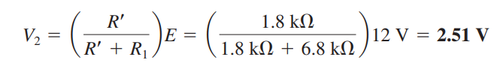
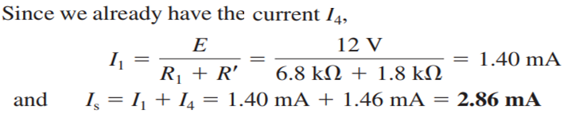
The result is that I4 can be determined directly using Ohm’s law as follows:
Because the total voltage across the series combination of R1 and R՛ is 12 V, apply the voltage divider rule to determine voltage V2 as follows:
*
‹#›

Slide 15
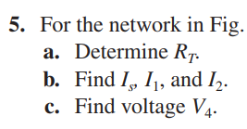
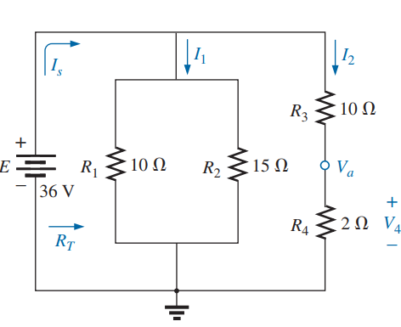




*
‹#›

Slide 16
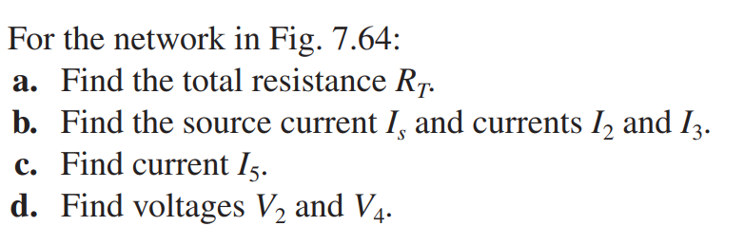
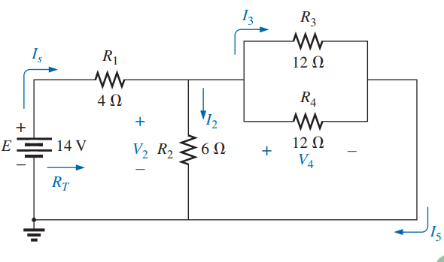
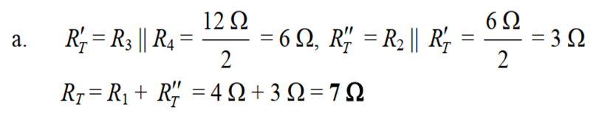




*
‹#›

Slide 17
7.4 Block Diagram Approach
Elements which can be reduced are grouped. You can examine the impact of the individual components in each group.
This grouping of elements is called the block diagram approach.
For series resistors R₁ and R₂, a comma is inserted between their subscript notations: R_{1,2} = R₁ + R₂
For parallel resistors R₁ and R₂, the parallel symbol is inserted between their subscripted notations: R_{1||2} = R₁ || R₂

Slide 18
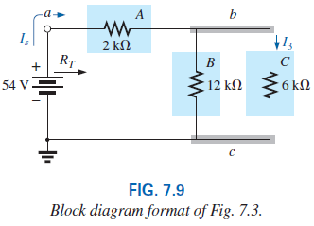
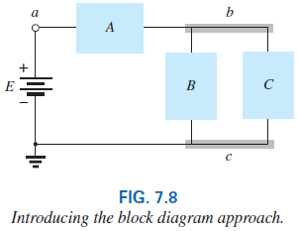
7.4 Block Diagram Approach

Slide 19
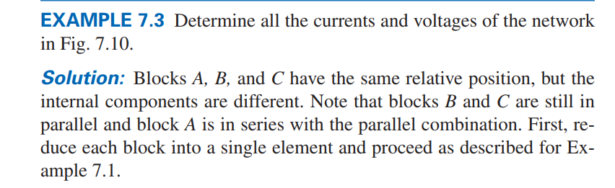
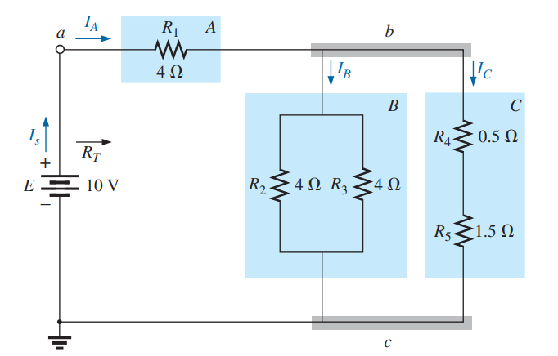

Slide 20
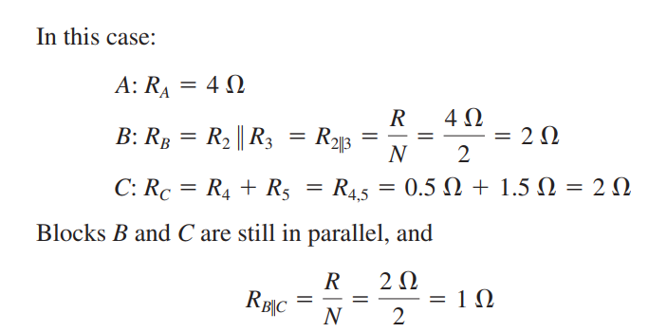
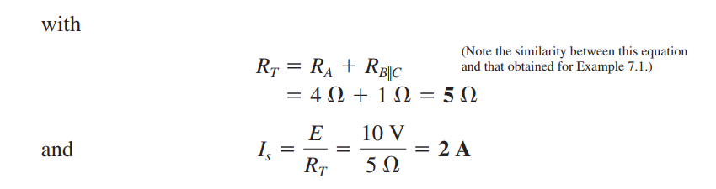

Slide 21
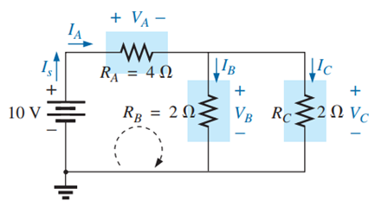
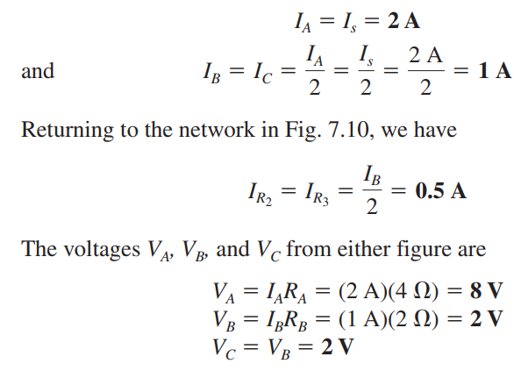
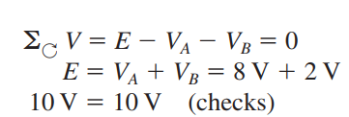

Slide 22
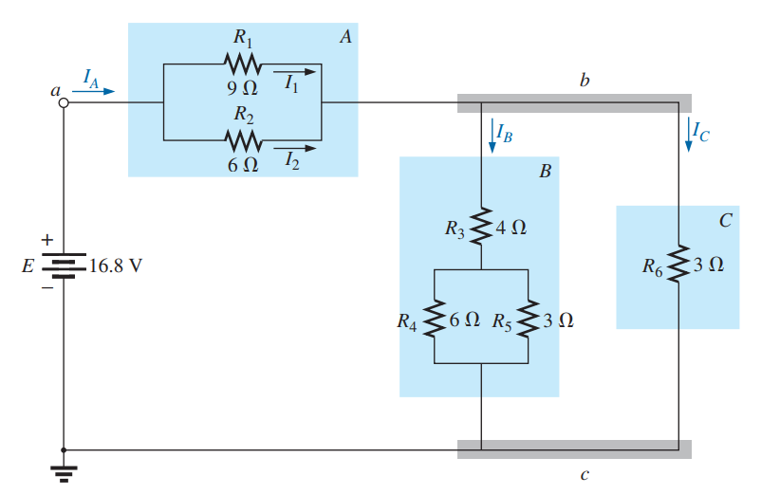
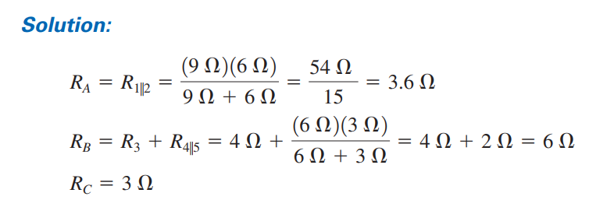



Slide 23
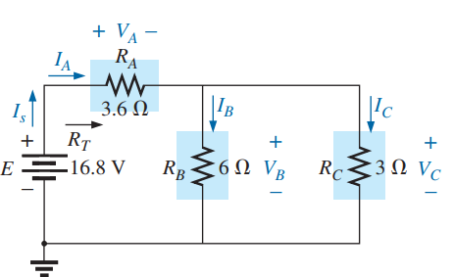
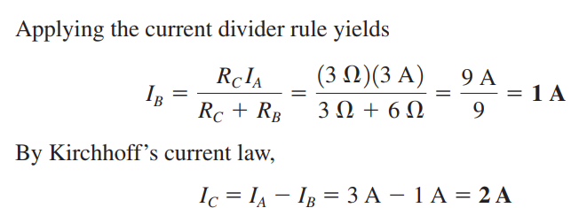

Slide 24
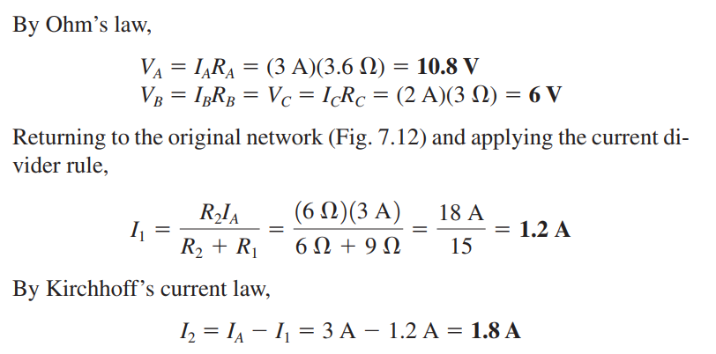

Slide 25
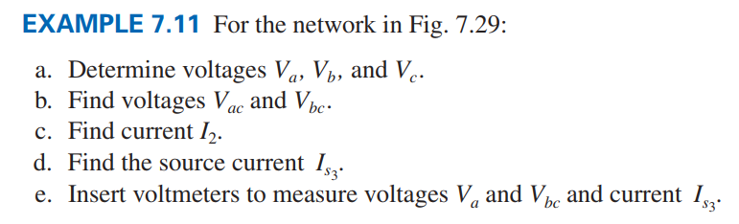
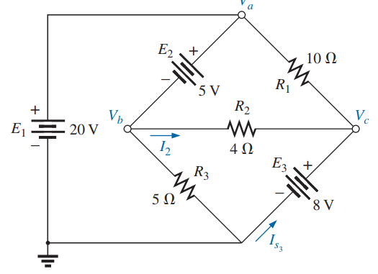

Slide 26
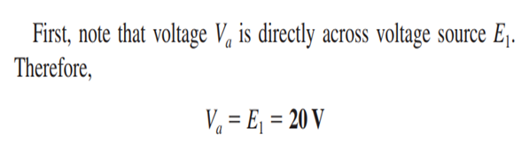
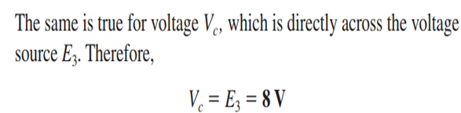
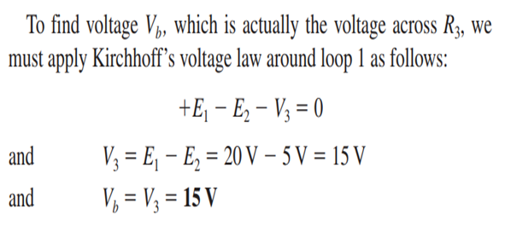

Slide 27

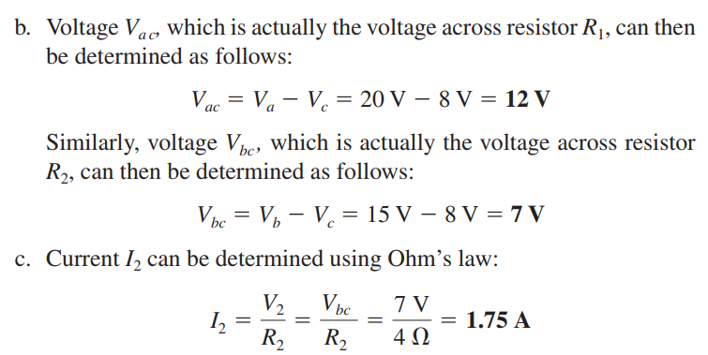

Slide 28
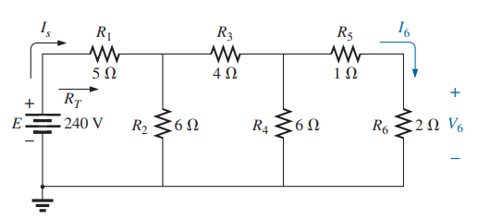
7.5 Ladder Network
A three-section ladder network appears in Fig. 7.32. The reason for the terminology is quite obvious for the repetitive structure. Basically two approaches are used to solve networks of this type.

Slide 29
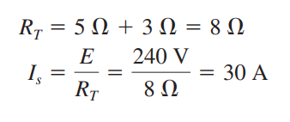
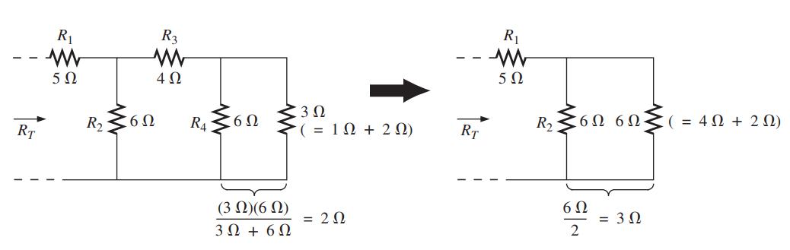
Method 1

Slide 30
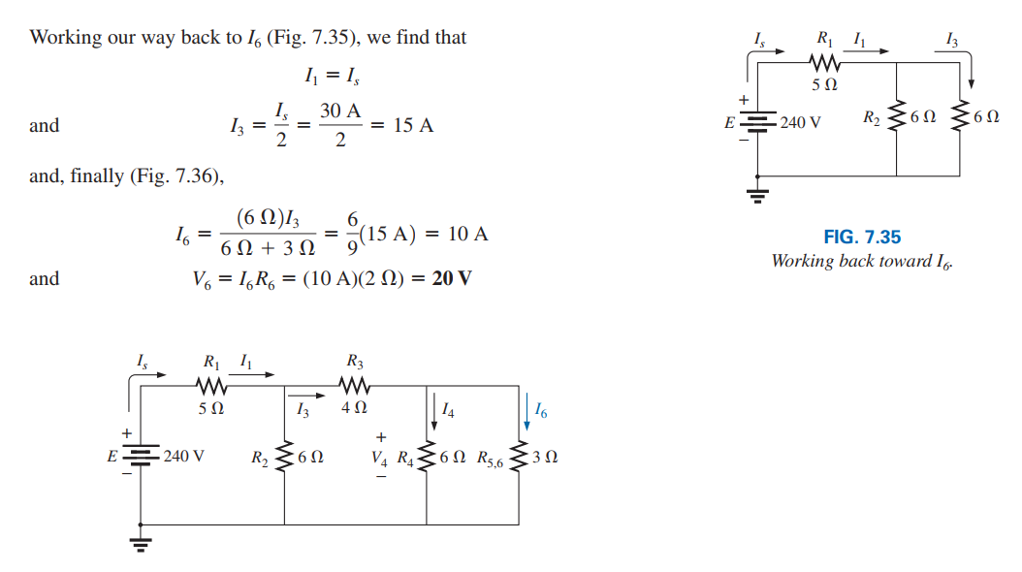

Slide 31
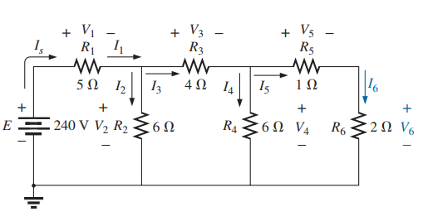
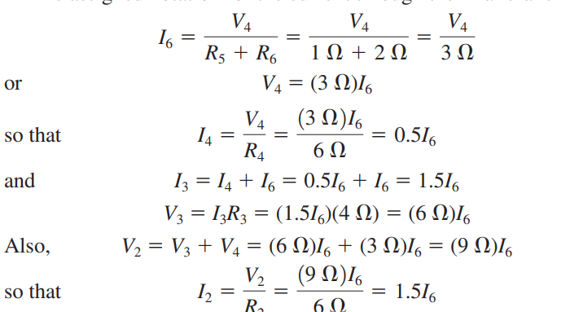
Method 2: Assign a letter symbol to the last branch current and work back through the network to the source, maintaining this assigned current or other current of interest. The desired current can then be found directly.

Slide 32
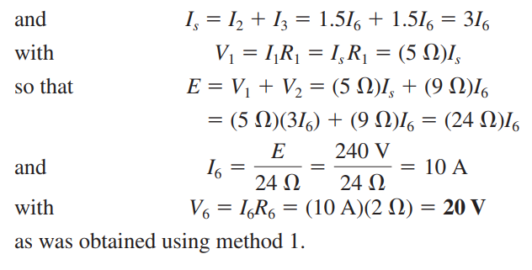

Slide 33
Thank You
*
‹#›

